Slide 1
steel

Slide 2
Abstract
The manufacture of reliable products is tied to material selection.
The examination of the chemical components, electrical and electronic devices and structural components is any material used in manufacture of products whether automotive, home appliances or manufacturing machines is pivotal.
This project aims to analyze steel as one on the widely used material in engineering by discussing its chemical composition, chemical structure and related features and steel related standards such as the ASTM.
Steel is majorly made up of irons and carbon, weighing approximately 0.2% and 2.1%, respectively.
These components of steel are known as an alloy.
Every year, approximately 750 million tons of steel are produced worldwide with less effect on the environment (Hoefer et al.,2018).
Notes:
The worth of steel in infrastructural industries and its contribution to economic growth is undeniable. How is steel produced? Well, steel is one of the most mass-produced materials in the modern world. Every year, approximately 750 million tons of steel are produced worldwide with less effect on the environment (Hoefer et al.,2018). Furthermore, the produced steel is recyclable and is relatively cheap to produce as it requires less energy in the process. This project will introduce and describe how the steel is manufactured and show how it is tested and measured.

Slide 3
Introduction
The Steel considered as most important engineering and construction material.
It can be recycling many times without losing any of its properties. It has a large strength; it comparatively needs small amount energy to be produced.
decades ago, the steel industry had huge efforts to reduce environmental pollution.
Nowadays, one tone of steel is produced just 40% of the energy that been in the sixties.
Also, the dust emissions have been changed to smaller amount.
Notes:
Steel dominates both the construction and engineering industries as the main raw materials. In almost every aspect of human life, steel is used, starting from cars, washing machines, cargo ships to surgical scalpels and spoons. The good thing with steel is that it can be recycled. Moreover, it is relatively cheap since it does not consume much energy during its production and possesses great durability compared to other materials.

Slide 4
Definition
Steel- Steel is an alloy of iron and a number of elements that include carbon.
Steel is majorly made up of irons and carbon, weighing approximately 0.2% and 2.1%, respectively.
Notes:
In almost every aspect of human life, steel is used, starting from cars, washing machines, cargo ships to surgical scalpels and spoons. The good thing with steel is that it can be recycled. Moreover, it is relatively cheap since it does not consume much energy during its production and possesses great durability compared to other materials. Compared to steel production in the 1960s, steel production has greatly improved and enhanced environmentally friendly measures in its production. Steel is made from iron ore by removing oxygen and other impurities. Pure iron is then combined with carbon, recycled steel, and some amount of other relevant elements. This process passes through two routes, blast furnace-basic oxygen and electric arc furnace route. All these processes are discussed below.

Slide 5
Chemical Compositions, structure and related properties of Steel
Steel is an alloy of iron and a number of elements that include carbon.
The elements that make up steel can be added intentionally to make steel have certain features and properties while others are accidentally present as impurities during its extraction [2, 3].
There are numerous steel alloys making their categorization very complex.
Varies governing bodies however present different directions of categorization of steel alloys.
Steel alloys are however generally classifying as Electrical Steel, Plain Carbon Steel, High Alloy Steel 5 (Stainless Steel and Tool Steel), Ultra Low Carbon (ULC) Steel, Alloy Steel, and High Strength Low Alloy (HSLA) Steel.
Notes:
Common element that are used for alloying in steel include; Carbon, Manganese, Phosphorous, Sulphur, Silicon, Copper, Nickel, Chromium, Molybdenum, Vanadium, Columbium (Niobium), Titanium, Aluminium, Nitrogen, Boron, Tin, Calcium. These alloying elements serve different but specific purposes in steel. Carbon is the core alloy in steel and its major hardening steel (3). The strength and hardness of Steel increases with increase in the amount of Carbon. Ductility, toughness and weldability on the other hand decrease with increase in carbon content in steel. Plain carbon steel grade has up to 0.95 percent Carbon, HSLA has 0.002 percent, ULC Steel has Carbon between 0.002-0.007 percent and HSLA Steel has up to 0.13 percent. Manganese is an element that is in all commercial Steel and serves the same purpose as Carbon (to increase hardness and strength) but in a lesser degree. Basically, added elements affect Steel strength, hardness, toughness, weldability, ductility and tensile strength. While most of these elements are added to Steel some exist as residuals in Steel and they include Copper, Nickel, Chromium, Molybdenum and Tin. A very important alloying element is Aluminium which is used as primary deoxidising agent in the making of steel. This is means that Aluminium reacts with oxygen in steel to form aluminium oxides that can easily float on slag. Additionally, it acts as a grain refiner when it combines with Nitrogen during hot rolling to form aluminium-nitride precipitate (2)

Slide 6
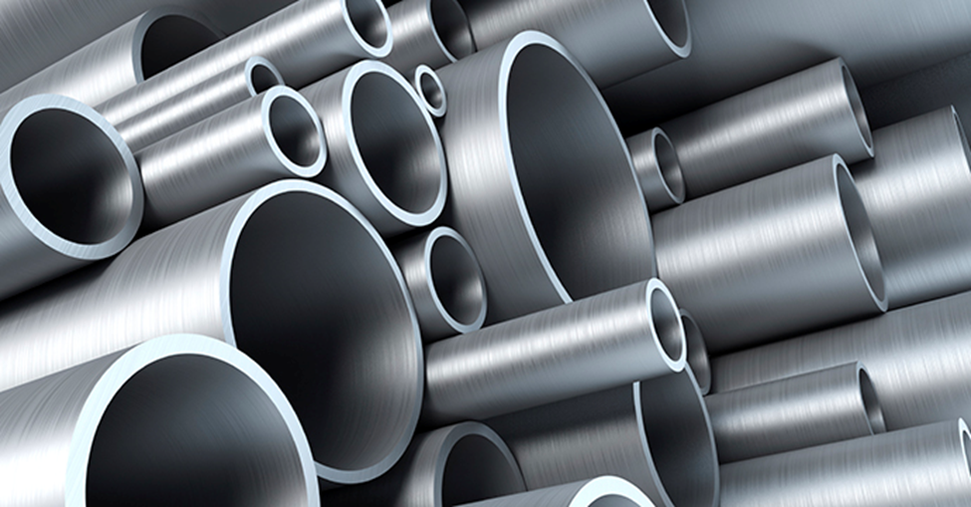
Examples of steel

Slide 7
Uses of steel
Steel is widely used material in the making;
satellite systems
commercial transport aircraft
military aircrafts
building and construction (sheets, poles, roofing, fences)
Making of home appliances such refrigerators, sinks, ovens, and televisions.
Its strength weldability and recyclability make it a desirable commercial material.

Slide 8
Process
Blast Furnace process
Henry Bessemer invented this process in 1850. He coined the term blast furnace from the process that involves blasting a hot air of about 1400 to 2100 degrees into the lower part of the furnace, which contains molten iron to oxidize the materials and do away with the heat impurities. The process reduces iron ore to iron. The process employs a steel cylinder lined with refractory, measuring about ninety meters in height. The cylinder is computer-controlled and filled with an environment control device. The blast furnace is considered to be the first method used to produce steel from iron oxides. This process uses iron ore, coke, and limestone to produce pig iron.
Making iron
The two raw materials, iron ore, and coke meet each other at the blast furnace along with some limestone.
Hot air is injected through tuyeres at the best of the furnace.
The blast races the temperature in the furnace to about 2200C, which is needed for chemical reduction to form a pull of molten iron at the bottom of the furnace.
The limestone combines with the impurities and floats at the top of the iron.
The combination of limestone and impurities is known as slag.
Molten iron is then tapped from the furnace.
Notes:
The slags are also removed as a waste product used in other industries such as road building or cement manufacturing companies.
The molten iron tapped from the furnace is not pure. Instead, it contains elements such as carbon, Sulphur, phosphorus, manganese, and silicon. To make steel, these elements must be removed from the molten iron because they are considered Impurities.

Slide 9
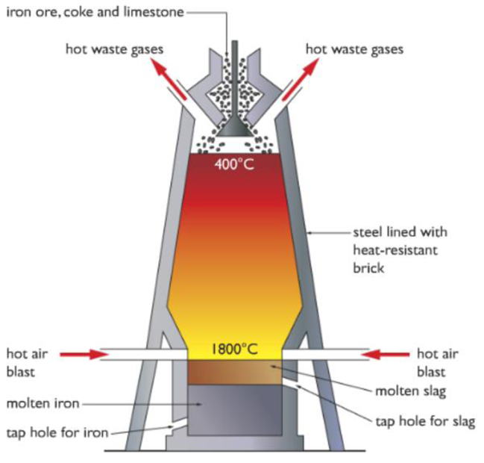
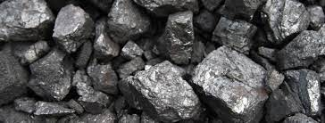
Blast Furnace process
Notes:
. The process reduces iron ore to iron. The process employs a steel cylinder lined with refractory, measuring about ninety meters in height. The cylinder is computer-controlled and filled with an environment control device. The blast furnace is considered to be the first method used to produce steel from iron oxides. This process uses iron ore, coke, and limestone to produce pig iron.
Step 1
Extracting iron ore
The process starts by finding a quality iron ore (Fe2O3). Then, the ore is mined and transported to the factory with a blast furnace.

Slide 10
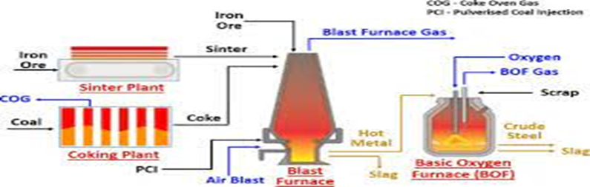
Step 4: Making steel Electric Arc Furnace
This is another method of making steel. It uses coal steel scrap to make steel. The process is considered to be one of the largest world recycling processes.
The furnace is filled with the recycled steel scrap
The roof is swag into place to cover the funnel, and three graphic electrodes are lowered into the furnace.
A powerful electric current then passed into the furnace.
An arc is created, and the heat is generated to melt the steel scrap in the furnace.
Lime is then added, and oxygen bellowed into the melt to separates impurities.
The steel is then sampled and analyzed if it has reached the correct temperature.
It is the tap of the furnace. At this stage, alloys can be added to meet the customer's specifications.

Slide 11
Basic Oxygen Steelmaking
This is the main process of refraining iron into steel.
Scrapped steel is put into the vessel
Molten iron is then added.
Oxygen is bellowed into the melted oxygen at high speed. The oxygen combines with the impurities. This oxidation produces heat. Temperature is controlled by adding iron ore as a coolant. The oxidized carbon creates a carbon monoxide gas which is extracted and used as fuel. Other impurities are combined with lime that was added during the blow to form a slag.
Notes:
The quantity of the scrapped hot metal, lime, and other elements are then calculated to ensure the correct temperature and composition of the steel. Refining is then done by adding argon, nitrogen, or oxygen gases through the vessel's base. Alloying additions are made during tapping to adjust steel composition. During this stage, carbon is reduced from about 4% to about 0.05%. The vessel is then tilted to remove the slag for recycling.

Slide 12
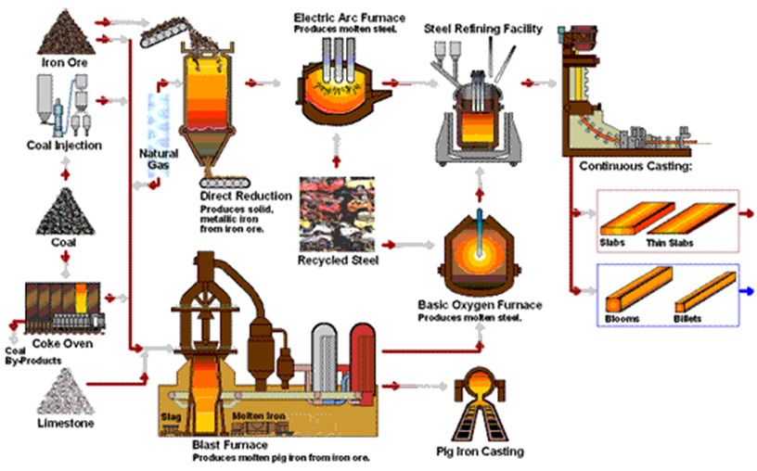
Step 4: Secondary steelmaking
The process involves further refining of steel.
The process aims at improving the temperature and consistency within the steel.
In addition, the process allows the removal of gases such as Sulphur and allows the addition of alloys to ensures steel meets the desired specification.

Slide 13
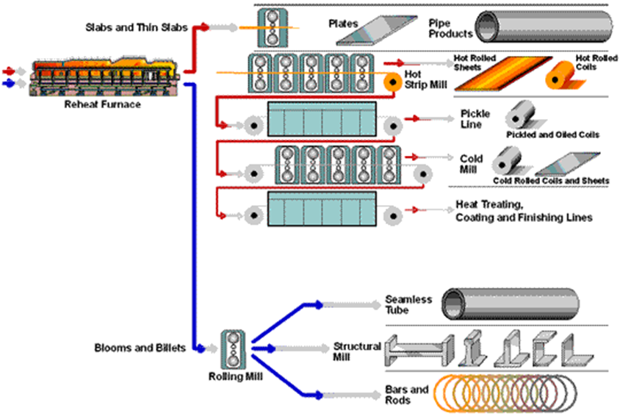
Step 5: Continuous Casting
This is the process that aims at solidifying steel ready for shaping.
Molten material of steel is introduced into a mold and then allowed to solidify within the mold and then later ejected to produce or make fabricated parts.
Melted steel is poured through a gas-tight refractory tube into a tundish.
The melted steel is then passed through a numbered of water-cooled copper molds.
Notes:
. The flow rate is controlled during this process, and only the outer shell of the steel solidifies as it passes through the copper mold. It is then drawn from the bottom of the mold through a curved arrangement of support draws and water sprays. The finished steel emergence horizontally and is cut into desired lengths by automatic gas banners. The solid shapes of the steel are named depending on their sizes. These names include Billet, Bloom, and slab, which are ready for shaping into finished products and use for different purposes.

Slide 14
Importance of hot steel rolling
When cold, steel is high resistance to rolling.
Therefore, rolling is done when the steel is still hot or in the molten state to make rolling easier.
Before rolling, an analysis must be done to ensure that the steel is at the right temperature by filling it into a furnace where it travels through numerous temperature-controlled zones until the correct or desirable temperature has arrived.
Then, the molten steel is squeezed through rolls until the desired shape and thickness are achieved. To enhance rolling, the rolls must exact millions of newtons equivalent to millions of tons of steel.
Notes:
The rolls run in massive bearings mounting to thousands of great strengths and driven by powerful electoral motives known as mills stand. The layout of rolling mails varies from a single simple stand to several stands. Depending on the product desired, the mill stand has varied roll arrangements. The rolling process is computer-controlled and is being monitored after every fifty times per second.

Slide 15
Standards for steel
The American Society for Testing and Materials (ASTM) has laid down steel standards to evaluate, classify, specify, chemical, metallurgical and mechanical elements of steel (ASTM Handbook, 2002).
These standards are used production of industrial parts, mechanical components, construction elements, and all their related accessories.
To mention a few the ASTM has developed standards on architectural metal fence systems, steel bars, Chain link fence, and wire accessories, machinery and piping systems, steel sheet specifications, stainless and alloy steel tubular products, steel plates for pressure vessels and boilers, among others (ASTM Handbook, 2002).
Notes:
Steel is a widely used material in the making of satellite systems, commercial transport aircraft, military aircraft, building and construction (sheets, poles, roofing, fences), making of home appliances such refrigerators, sinks, ovens, and televisions. Its strength, weldability, and recyclability make it a desirable commercial material.

Slide 16
Reference
Handbook of comparative world steel standards. ASTM. Bringas, J. E. (2002). [Accessed: April 5, 2021]
Hoefer, K., Haelsig, A., & Mayr, P. (2018). Arc-based additive manufacturing of steel components—Comparison of wire-and powder-based variants. Welding in the World, 62(2), 243-247.

